Slide 1
Aramco Upstream Solutions Technathon 2019 IoT challenge Design of a Smart Seismic Node
Anton Egorov
Aramco Moscow Global Research Center

Slide 2
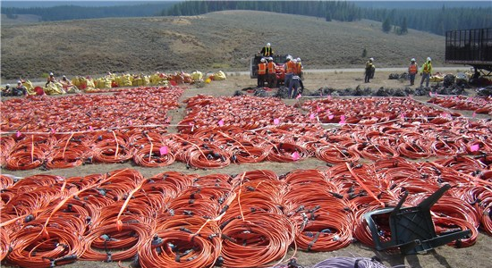
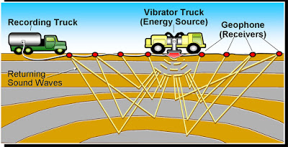
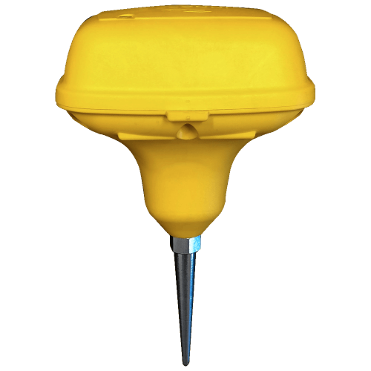
Motivation – seismic acquisition
Traditional seismic acquisition uses wired systems. Wires complicate the acquisition process.
Modern onshore seismic acquisition needs flexible wireless system that will:
Simplify the equipment layout for seismic surveys
Allow easy quality control
Be energy-efficient
Provide some internal data preprocessing
Too many wires!
Going wireless is a solution!
Figure sources: geologylearn.blogspot.com/, inovageo.com/products/quantum

Slide 3
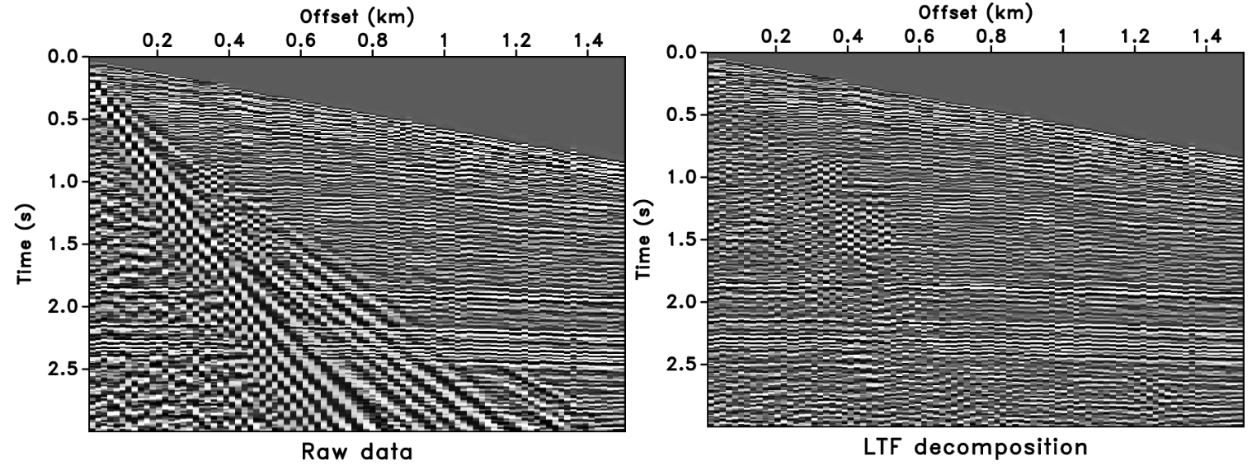
Motivation – internal preprocessing on seismic nodes
Current generation wireless nodes can:
save the data on internal hard drive
transmit the data to the recording station.
Internal processing on the node (e.g. filtering in 2D/3D Fourier transform domain) would allow one to:
Minimize processing time
Optimize processing workflows
Save disk space (one copy of typical survey 10-100 TB)
We attempt to create a scaled-down simpler example – calculation of coordinates via trilateration on the node.
Figure sources: ahay.org

Slide 4
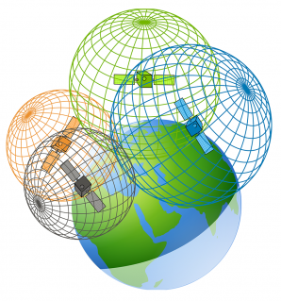
Scaled down on-the-edge processing - trilateration
A method used most famously for GPS location – the position of your phone is computed by analyzing the distances between your phone and a few satellites.
Our case – a similar 2D problem.
Imagine a system of seismic nodes on a 2D plane detecting a signal and internally calculating the location of the signal source (similar to earthquake detection).
Figure sources: https://gisgeography.com/trilateration-triangulation-gps/

Slide 5
Details of the challenge
X Axis
0,0 |  |  |  |  |  |  |  |  | 0,10
10,0 |  |  |  |  |  |  |  |  | 10,10
10 x 10 m grid
Three balloons will explode at unknown times, at unknown locations with intervals ~2 min
5 receivers for each team
Coordinates of the source must be calculated in almost-real-time by the receivers
Source coordinate must be broadcasted over network
SRC
Y Axis
Notes:
Broadcasting to a webpage over Wi-Fi network is the best option, so that the expert can just open 5 webpages on his laptop during the experiment (one for each team) and see the results in real-time.
If that does not work, we can discuss other options.

Slide 6

Evaluation of the performance
Each team must provide a wireless receiver network and take part in the experiment.
Evaluation metrics:
RMS error of the coordinates obtained in the experiment.
A presentation with the solution explaining:
Signal detection and high-accuracy source coordinate calculation on the IoT devices
Receiver network topology
Scalability of the solution
Notes:
Extra points: good design, internal preprocessing of the recorded signal for more robust detection, energy saving, external control of the receiver network (e.g. monitoring the connectivity of the receivers).

Slide 7
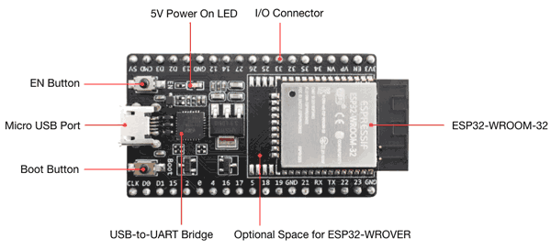
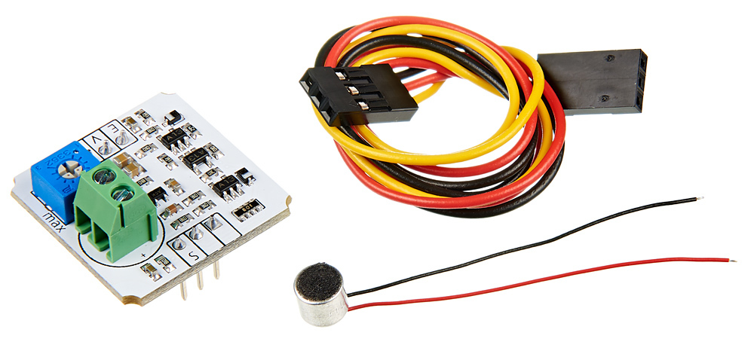
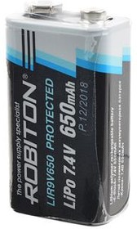
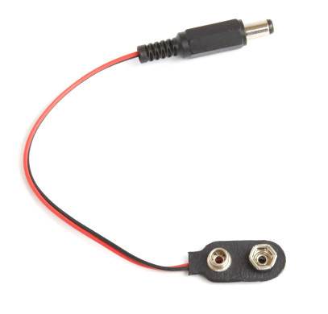
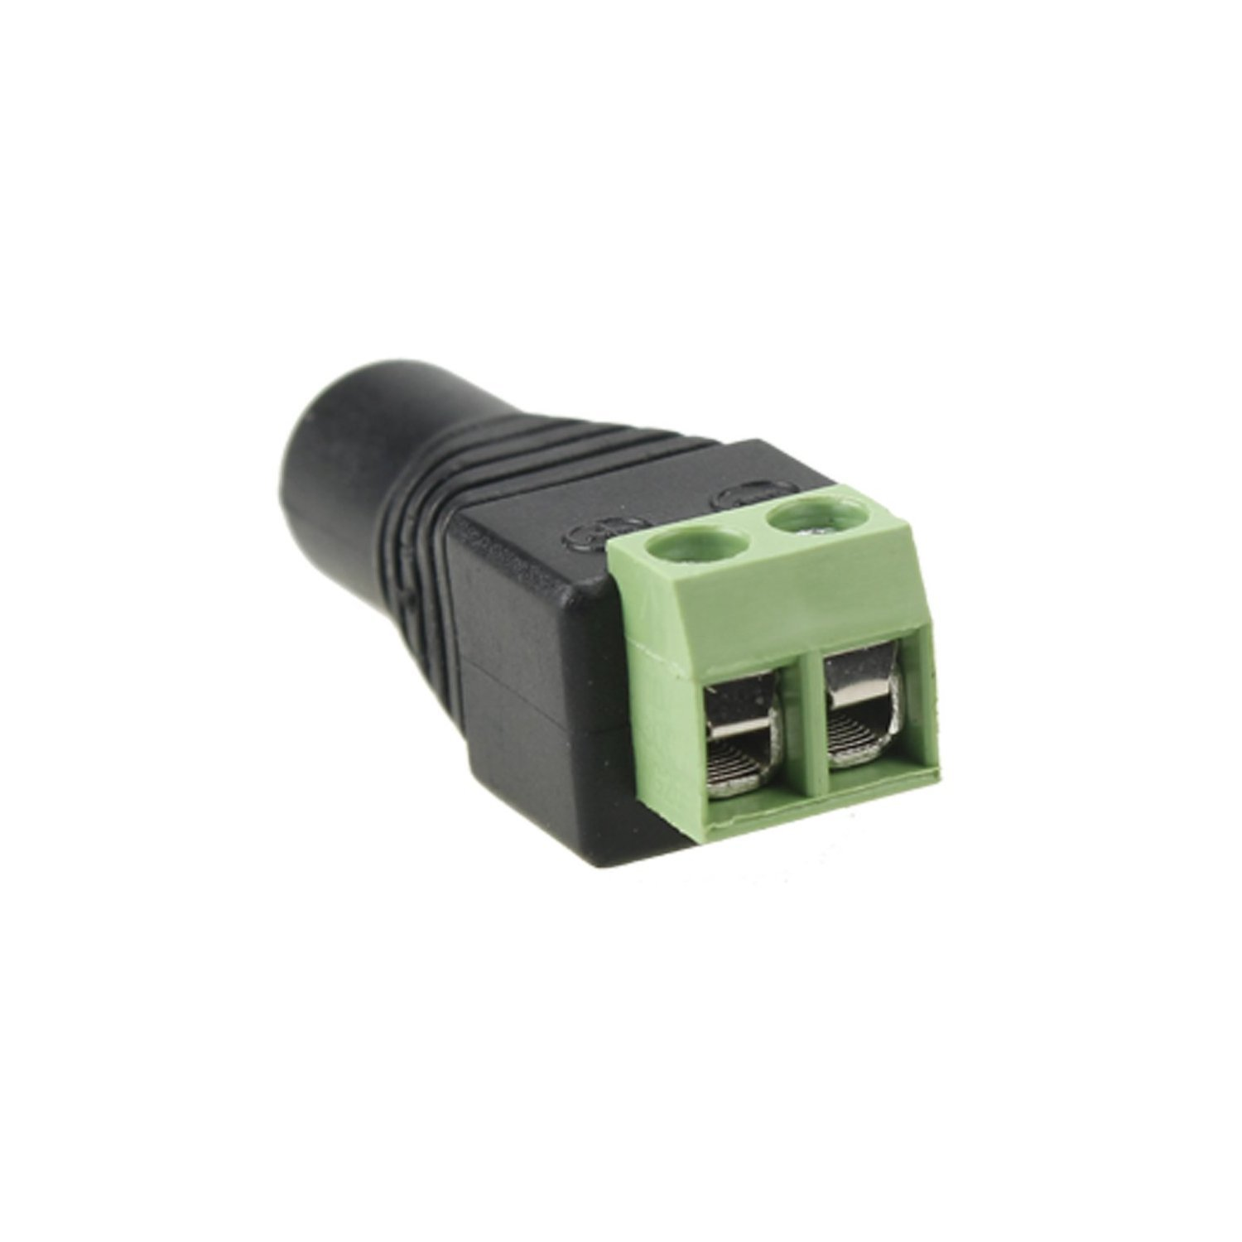
Supplies
Each team receives:
5 x ESP32 DevKitC boards (WiFi/Bluetooth/ESP-NOW) (https://docs.espressif.com/projects/esp-idf/en/latest/hw-reference/get-started-devkitc.html)
5 x Troyka loudness sensors (https://amperka.ru/product/troyka-sound-loudness-sensor)
5 x 7.4V LiPo batteries
5 x Battery connectors
Battery charger
Wires for solderless connections
Insulation tape
Access to a 3D printer
This presentation with some tips in the notes: https://github.com/aramcoinnovations/technathon2019.git
Notes:
ESP boards have a voltage regulator on 5V input, meaning that they can take the power directly from this 7.4V battery. However, they still generate heat, and it is recommended not to keep them on the battery for too long.
We have special power cords to power the battery chargers, as they do not fit into most electric outlets (however the batteries are charged from the start).
We also have a screwdriver to fit the microphone into the sensor, teams need to do the rotation of that.

Slide 8
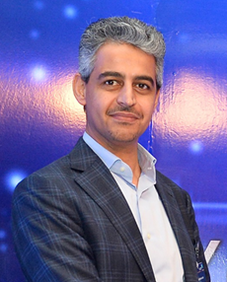
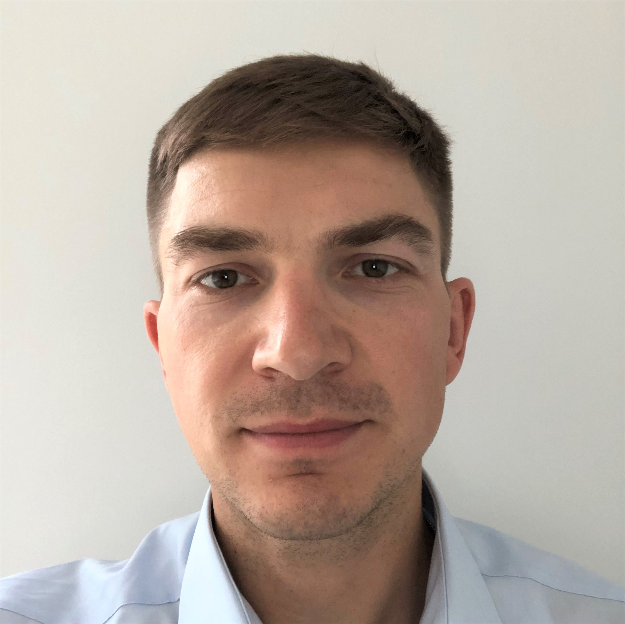
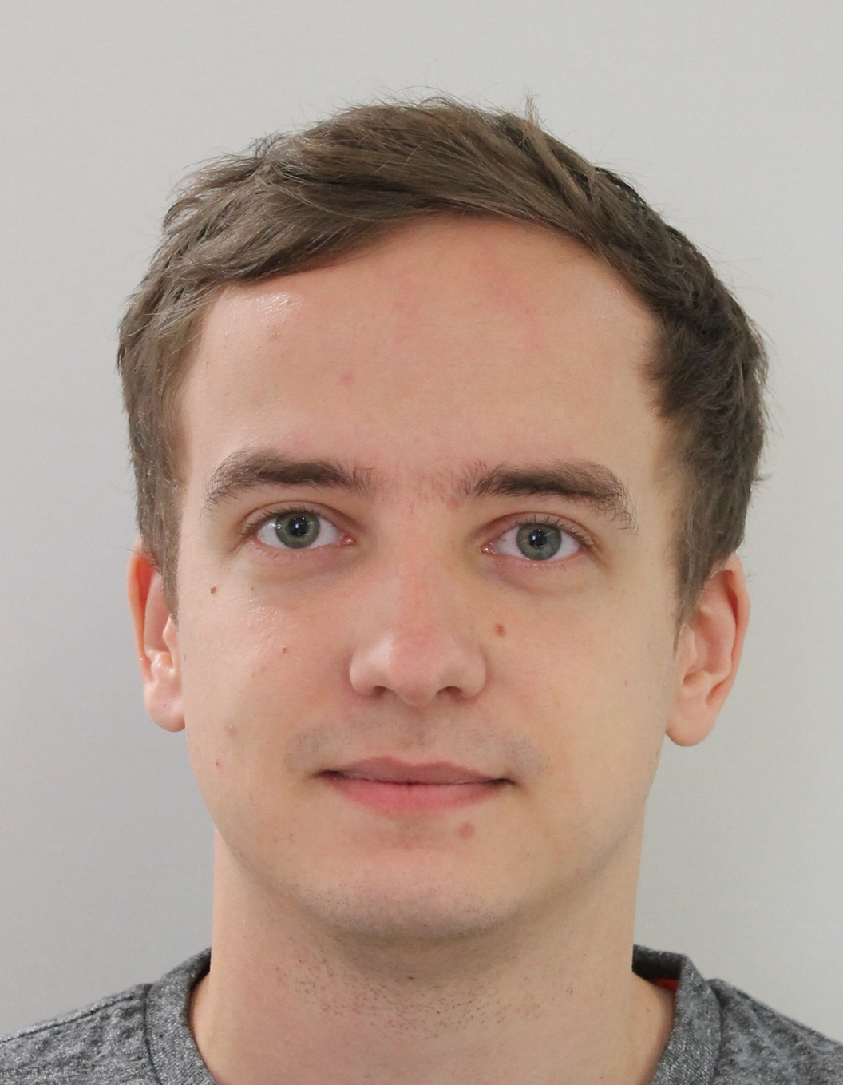
Subject Matter Experts
Mustafa Al-Ali Aramco Moscow Global Research Center
Email: mustafa.ali@aramcoinnovations.com
Pavel Golikov Aramco Moscow Global Research Center
Email: pavel.golikov@aramcoinnovations.com Phone: +7 906 054 2034
Anton Egorov Aramco Moscow Global Research Center
Email: anton.egorov@aramcoinnovations.com

Slide 10
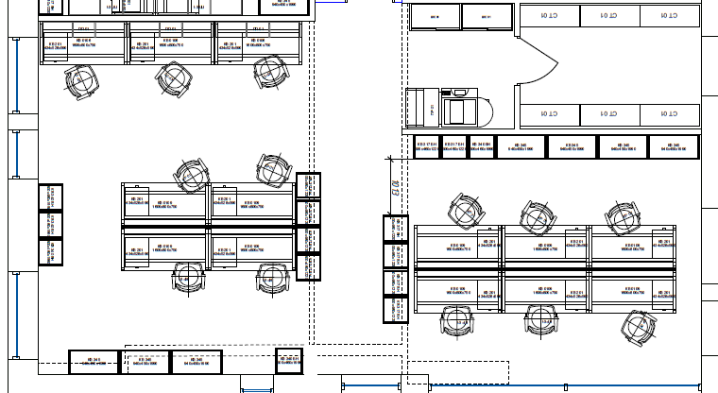
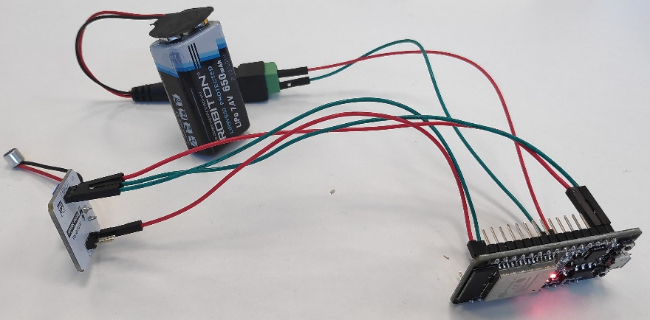

Supplies – Preliminary experiment
Smart node v0.1
Power
Mic
Source 2
9.5m
IoT board
Sound Source
1.5m
Smart node
Source 1

Slide 11
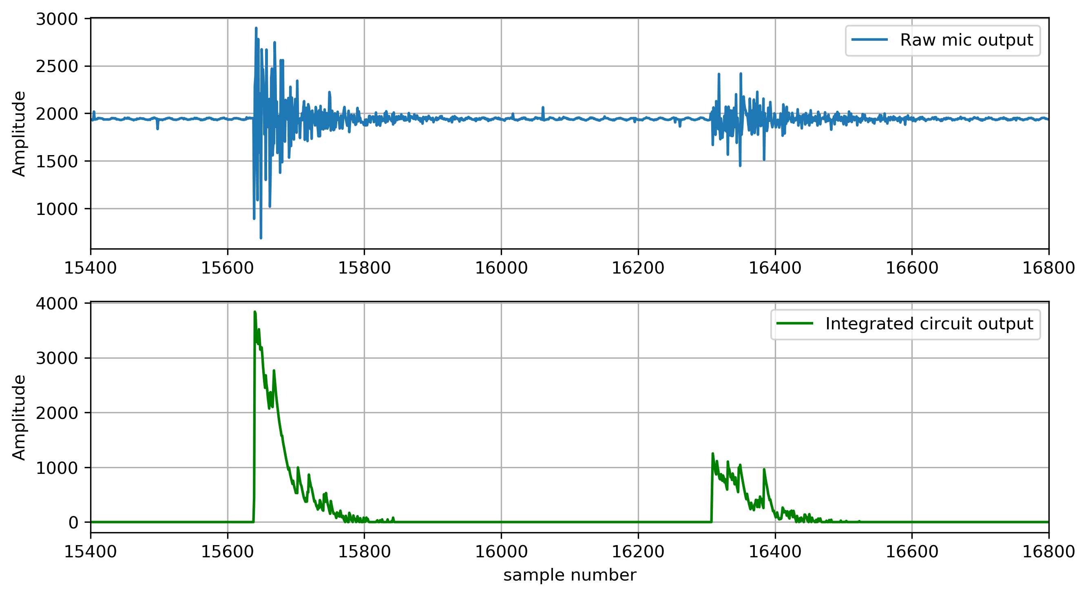
Supplies – Preliminary experiment
Source 1
Source 2
Clear first break
200ms
Sample rate approx. 1000 Hz
The recording of two balloon explosions with a ESP32 device and an external microphone. Microphone has two outputs – the raw output, and an output from an integrated circuit, which removes the noise and integrates the signal energy.

